Slide 1
What is IoT?
An Introduction
Uli Raich (uli.raich@gmail.com)
Formally CERN, Geneva, Switzerland

Slide 2
What is IoT?
Answer: IoT is the Internet of Things
But… what is the Internet of Things?
I hate buzz words!
Everybody talks about IoT but who does deeply know, what IoT actually is?
Who is able to set up an IoT by himself?

Slide 3
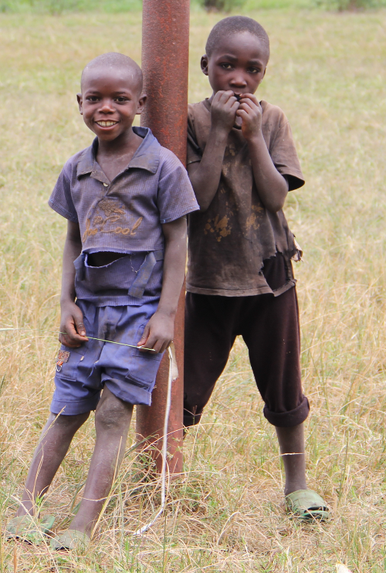
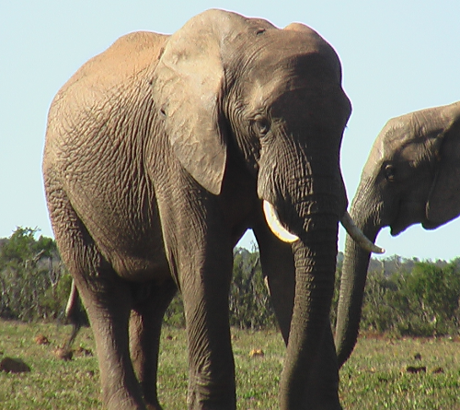
The child and the elephant
Child: “What is an elephant” Me: An elephant is a grey animal!
Result:
The child has got an answers and does not disturb me any longer
The child thinks that I am clever, because he thinks I know what an elephant is (which is not true!)
The child does not know much more than before

Slide 4
What should I have done?
Learned about elephants myself
Told him everything about elephants I know myself:
Where and how they live
What they eat
How they behave …
Gone to the zoo (in Europe) or a nature reserve (here in East Africa) to show him a live elephant.

Slide 5
Now about IoT
I have learned about IoT during the whole last year
I will take these 20 mins to tell you what I know about IoT
I have brought a baby elephant (IoT system) to show you a live example

Slide 6
What is the “I” in IoT ?
The “I” stands for Internet. This means:
We need a processor (IoT node) that can connect to the Internet. It must be powerful enough to run Internet protocols and it needs an interface to the Internet.
Ethernet interface
WiFi interface
GSM
… connection to a gateway with access to the internet

Slide 7
What are « things » ?
Usually the Internet is used by humans
Typical applications are
WEB browsing
Email
Social media
Telephone and chats
Human to machine or human to human communication.
IoT: “Things” communicate also without human intervention.

Slide 8
Things, Sensors, Actuators
Coffee machines, dish washer, washing machine, …
Burglar alarm system
Intelligent farming
Weather station
Scientific measurements
Industrial factory control
Car electronics, ignition system, ABS,…
You name it!
The processor reads the state of “things” though sensors and controls them through actuators. Our processor needs interfaces to these sensors and actuators.

Slide 9
The IoT system
We need a system with a number of processors that read out sensors and/or control actuators
These processors communicate with each other over the Internet with or without human intervention.
Design decisions:
Which processors?
Which communication protocol
Which GUI to be able to see what is going on?
Which programming language?

Slide 10
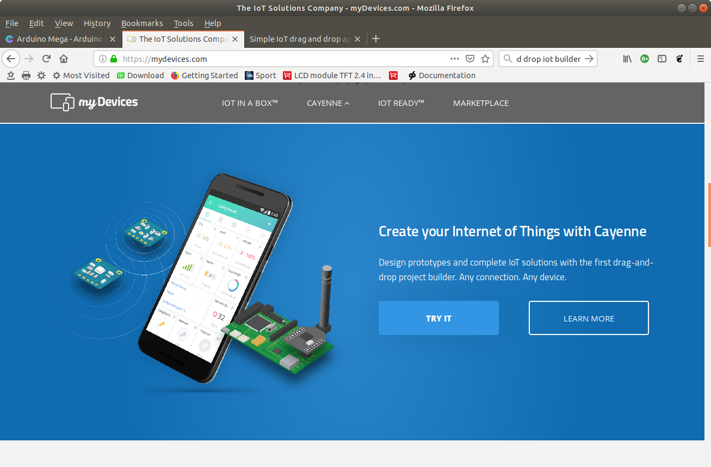
The application
We need an application to see the state of the IoT

Slide 11
The processor
Raspberry Pi
Advantages:
Has all Internet interfaces needed
Very powerful, any programming language can be used, native development
Disadvantages:
Rather expensive
Has no ADC
Arduino
Advantages:
Low price
Has 10 bit ADC on chip
Disadvantages:
Has no Internet interface
Little resources in flash and RAM

Slide 12
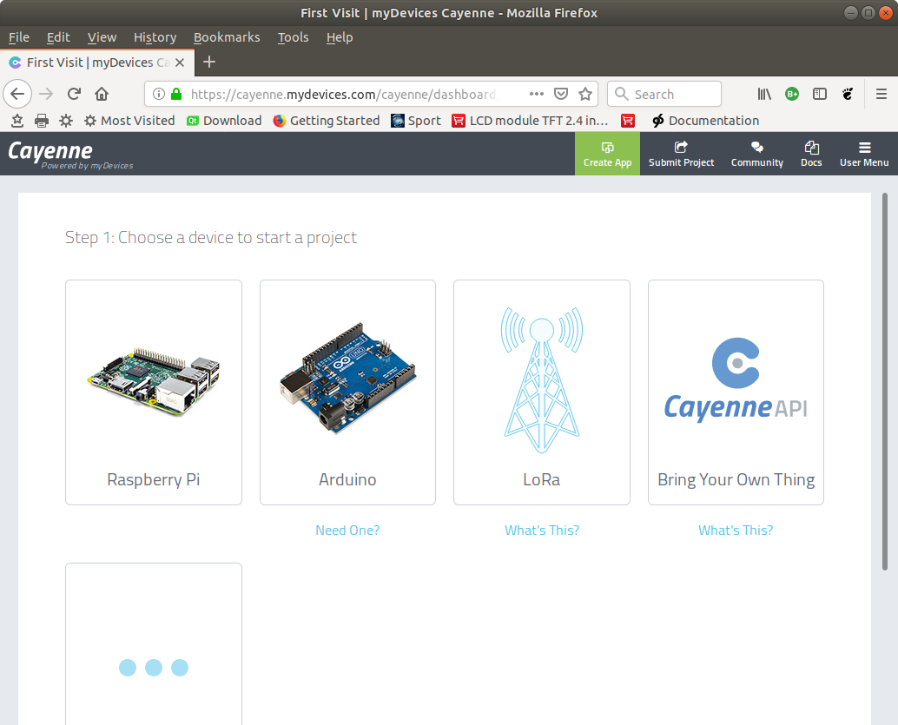
Cayenne’s proposal of processors

Slide 13
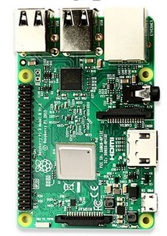
The Raspberry Pi
The Raspberry Pi is a small computer powerful enough to run a full blown Linux operating system:
A quad core 1.2 GHz Broadcom 64 bit ARM CPU
1 Gbytes of Ram
Ethernet and wireless networks
4 USB2 ports
Micro SD connector
40 pin extended GPIO connector with
GPIO pins
SPI and I2C bus interface
Cost ~ 80-100 US $
No ADC

Slide 14
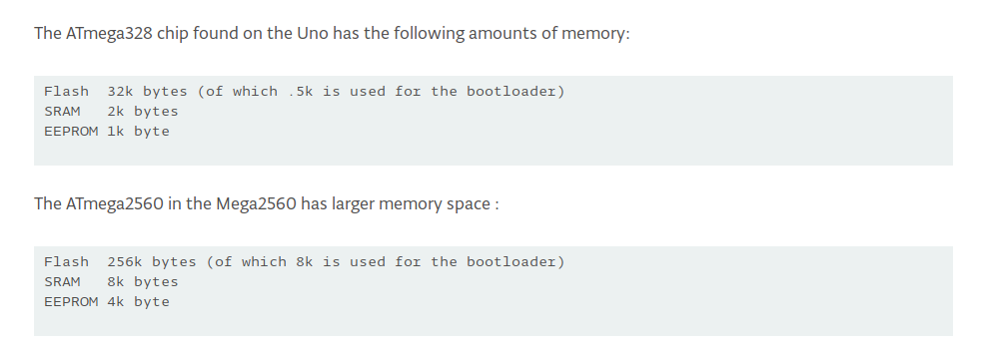
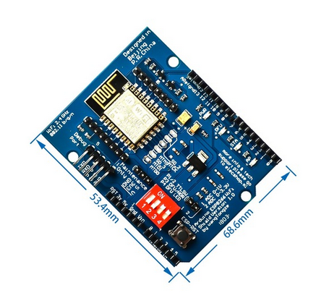
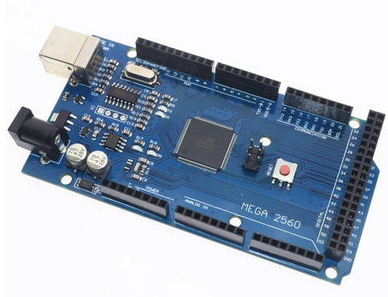
Arduino + WiFi shield
Cost: ~12-15 US $
Popular because of simple C++ IDE

Slide 15
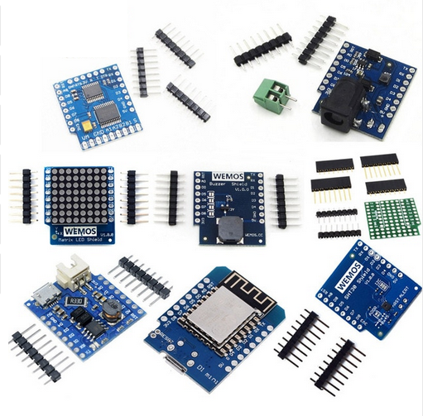
The ideal IoT solution?
ESP8266 or ESP32 processor board
ESP8266 specs:
WiFi on chip
10 bit ADC on chip
80 kByte RAM
4 Mbyte flash
Can run a MicroPython interpreter
Can be programmed through Arduino IDE
SPI, I2C interfaces
11 GPIO pins
Many sensor and actuator boards
Can be plugged together without bread board or soldering
Cost of processor board: ~ 2.5 US$
ESP32 is even more powerful Cost: ~ 4.5 US$

Slide 16
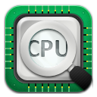
Communication
MQTT (Message Queuing Telemetry Transport): a publish-subscribe based
Message protocol running of top of TCP.
A processor can subscribe to messages of a certain “topic” and/or it can push its
results on a certain topic
broker
publish
subscribe

Slide 17
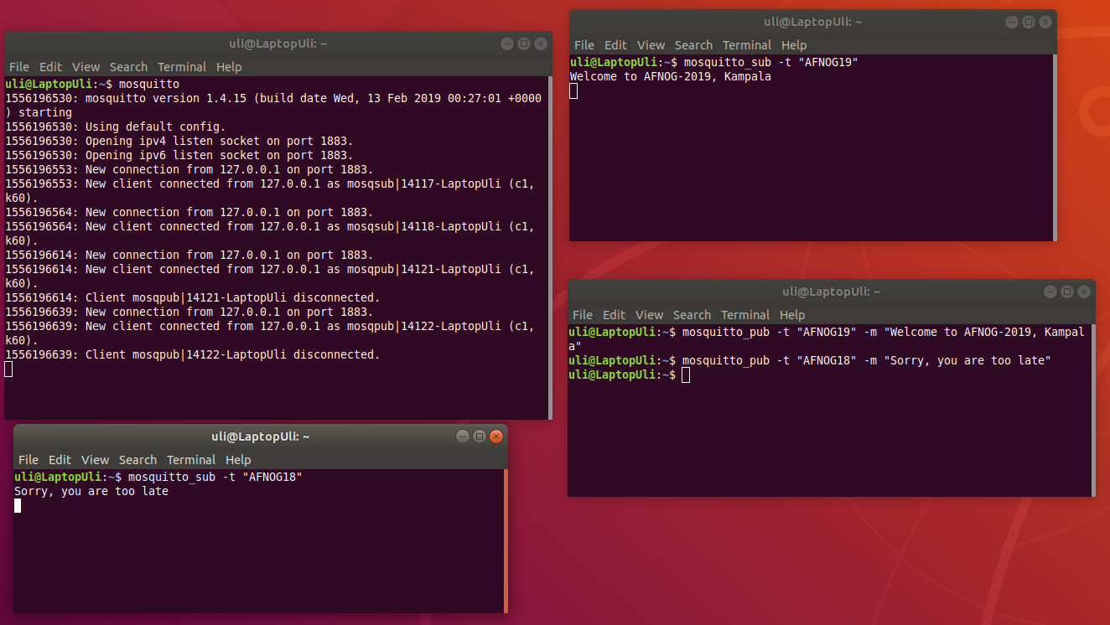
MQTT Demo
Video

Slide 18
Programming language
Only the data recovered from the communication protocol are seen
Any programming language will do
Cayenne/MQTT libraries are available for
C, C++
Python
Java
Java Script
ESP8266 and ESP32 are powerful enough to run a MicroPython interpreter Let’s use Python

Slide 19
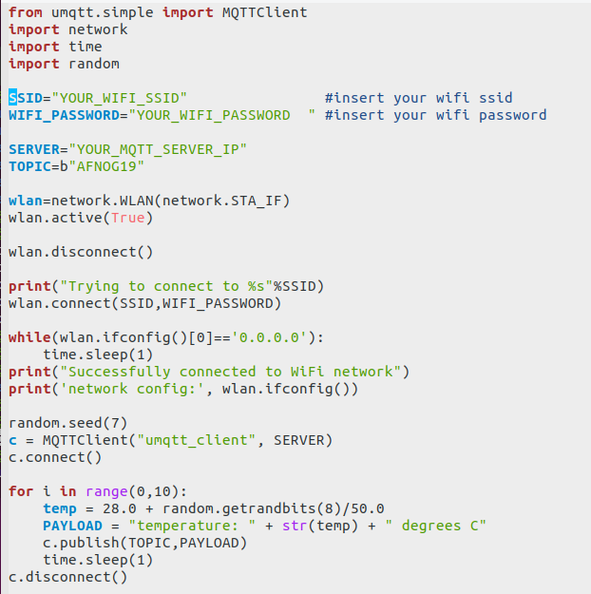
Sending Dummy temperature data
Video

Slide 20
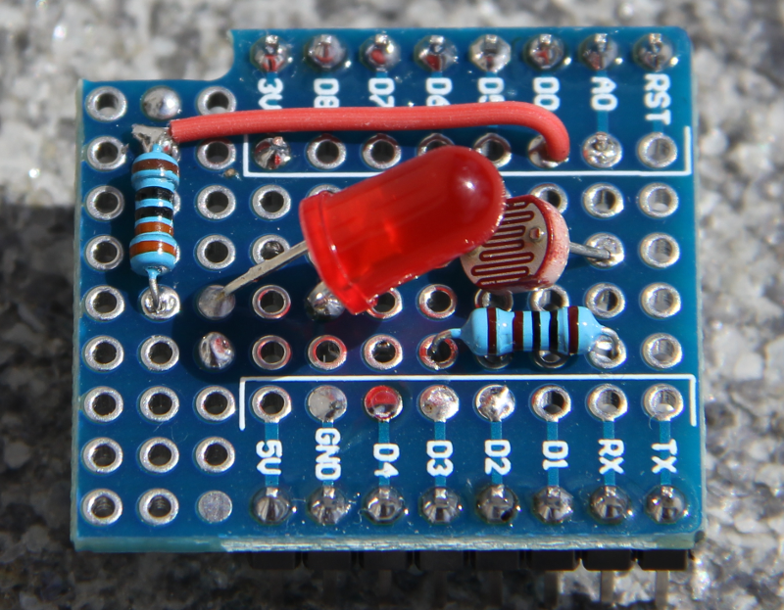
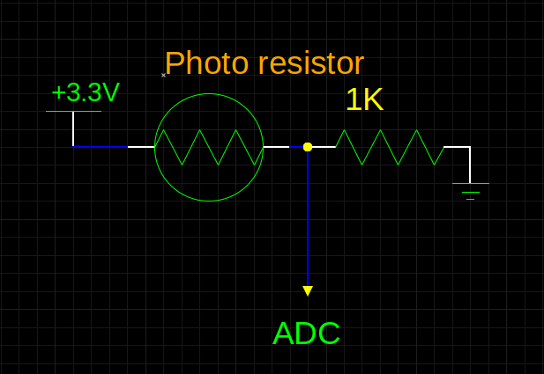
Sensor Readout example: Photo-Resistor and LED
The photo resistor and the 1 kΩ resistor form a voltage divider
The LED can be switched on by program and changes the light
Intensity seen by the photo resistor

Slide 21
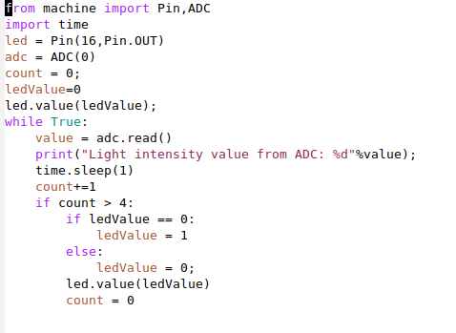
ADC readout
The ADC and GPIO driver classes are already available in MicroPython.
This makes readout a child’s game.
Video

Slide 22
Cayenne
Cayenne supplies the MQTT broker
It uses a dedicated format for “topic” and “payload”
We hide these details in a “Cayenne” Python class
Cayenne supplies widgets for display and control

Slide 23
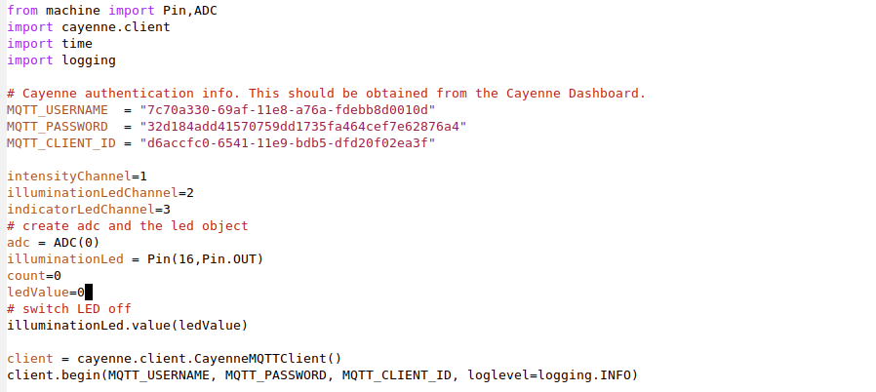
Cayenne definitions

Slide 24
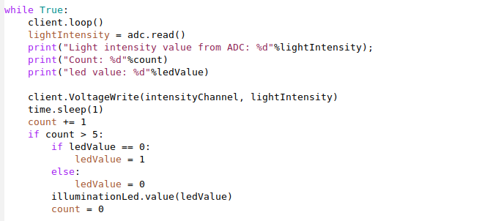
Publish to Cayenne

Slide 25
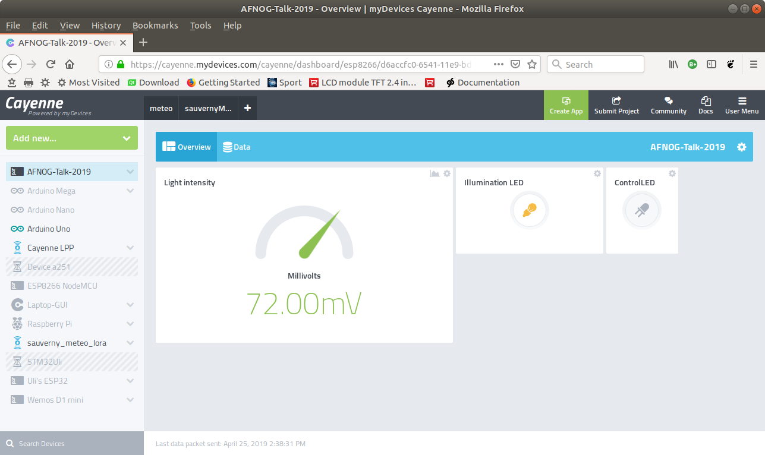
Results on Cayenne
Video

Slide 26
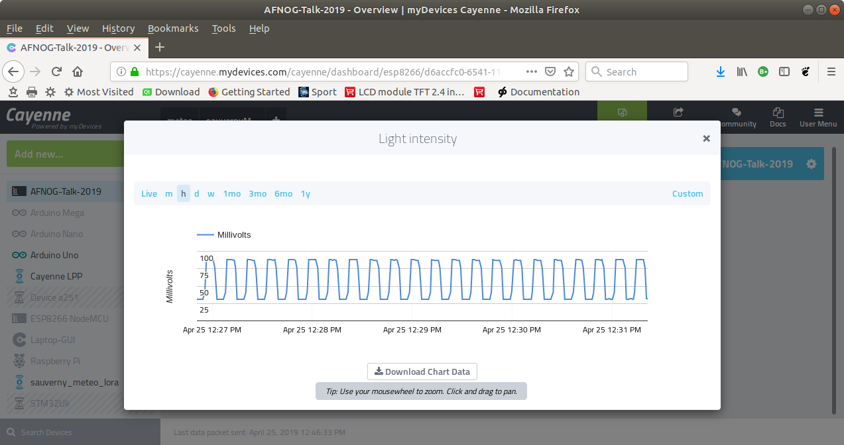
...or the history plot

Slide 27
Want to know more?
Unfortunately you missed the workshop on IoT at this conference
But you may have a look at its Twiki server
http://afnog.iotworkshop.africa
and/or, for the code of the demo programs:
https://github.com/uraich?tab=repositories
… or have a beer with me at the bar!

