Slide 1
Introduction to Internet of Things (IoT)
Session 1: Introduction to IoT and Python
Isaac Armah-Mensah
University of Cape Coast, Ghana

Slide 2
Introduction of Lecturers
Uli Raich -- Formally CERN, Geneva, Switzerland
Isaac Armah-Mensah -- University of Cape Coast Ghana

Slide 3
The TWiki Server
All information about this tutorial is available on a TWiki server.
TWiki uses the same documentation format as Wikipedia.
This makes it very simple for the lecturer to provide on-line documentation,which can be extended by students.

Slide 4
Links to Resources
Twiki server:
https://afnog.iotworkshop.africa/do/view
Micropython Demos:
https://github.com/uraich/MicroPython_IoTDemos
https://github.com/uraich/MicropythonCayenneMQTTClient
C++ version:
https://github.com/uraich/C-IoTDemos

Slide 5
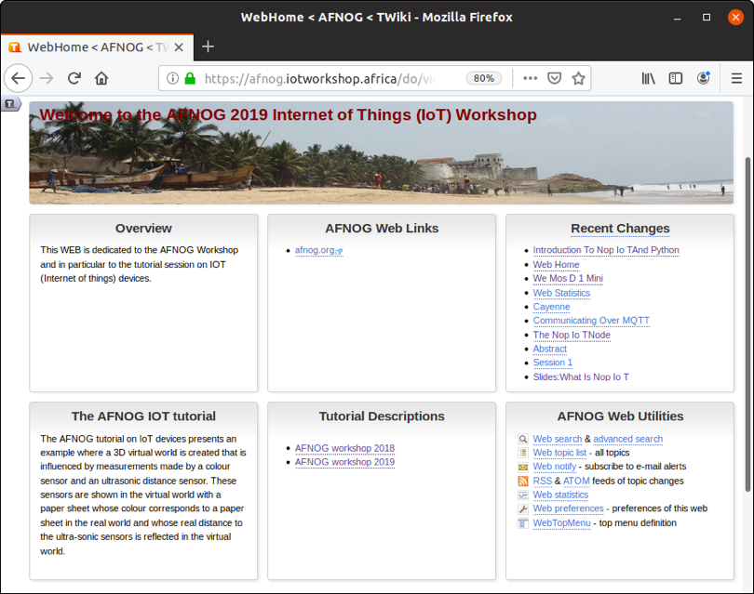
Workshop Page

Slide 6
What is the “I” in IoT ?
The “I” stands for Internet. This means:
We need a processor (IoT node) that can connect to the Internet. It must be powerful enough to run Internet protocols and it needs an interface to the Internet.
Ethernet interface
WiFi interface
GSM
… connection to a gateway with access to the internet

Slide 7
What are « things » ?
Usually the Internet is used by humans
Typical applications are
WEB browsing
Email
Social media
Telephone and chats
Human to machine or human to human communication.
IoT: “Things” communicate also without human intervention.

Slide 8
Things, Sensors, Actuators
Coffee machines, dish washer, washing machine, …
Burglar alarm system
Intelligent farming
Weather station
Scientific measurements
Industrial factory control
Car electronics, ignition system, ABS,…
You name it!
The processor reads the state of “things” though sensors and controls them through actuators. Our processor needs interfaces to these sensors and actuators.

Slide 9
The IoT system
We need a system with a number of processors that read out sensors and/or control actuators
These processors communicate with each other over the Internet with or without human intervention.
Design decisions:
Which processors?
Which communication protocol
Which GUI to be able to see what is going on?
Which programming language?

Slide 10
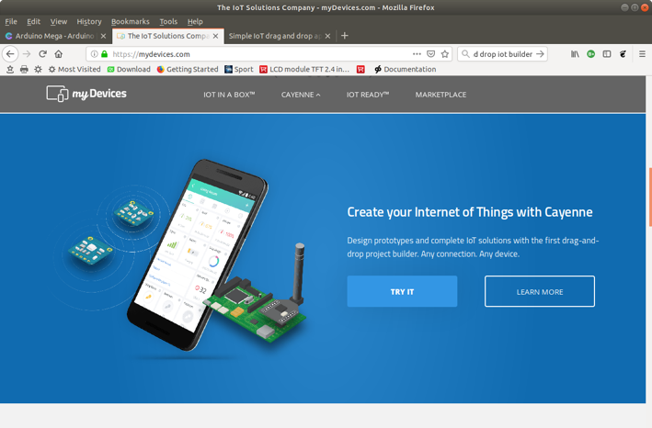
The application
We need an application to see the state of the IoT

Slide 11
The processor
Raspberry Pi
Advantages:
Has all Internet interfaces needed
Very powerful, any programming language can be used, native development
Disadvantages:
Rather expensive
Has no ADC
Arduino
Advantages:
Low price
Has 10 bit ADC on chip
Disadvantages:
Has no Internet interface
Little resources in flash and RAM

Slide 12
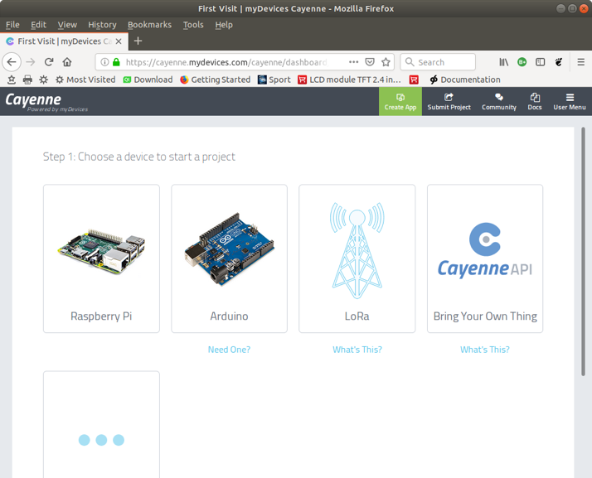
Cayenne’s proposal of processors

Slide 13
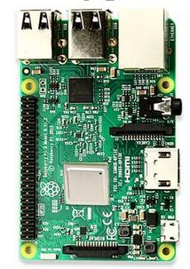
The Raspberry Pi
The Raspberry Pi is a small computer powerful enough to run a full blown Linux operating system:
A quad core 1.2 GHz Broadcom 64 bit ARM CPU
1 Gbytes of Ram
Ethernet and wireless networks
4 USB2 ports
Micro SD connector
40 pin extended GPIO connector with
GPIO pins
SPI and I2C bus interface
Cost ~ 80-100 US $
No ADC

Slide 14
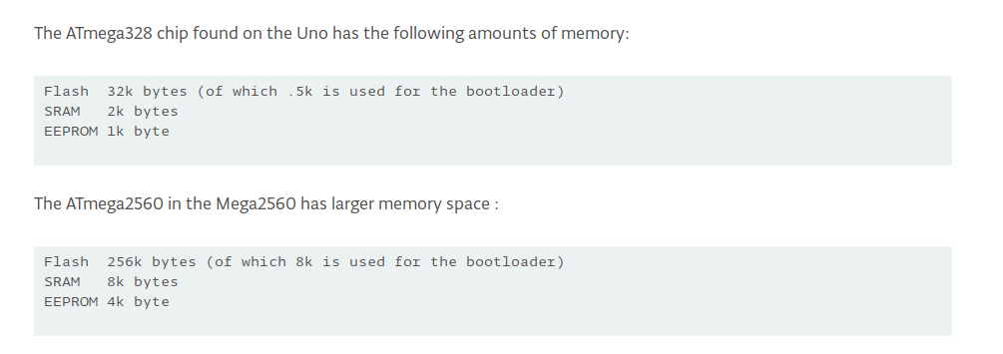
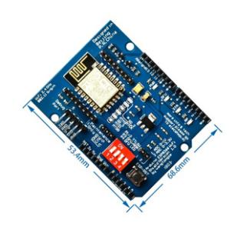
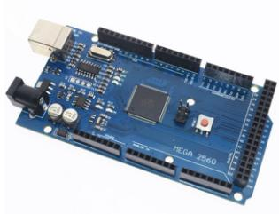
Arduino + WiFi shield
Cost: ~12-15 US $
Popular because of simple C++ IDE

Slide 15
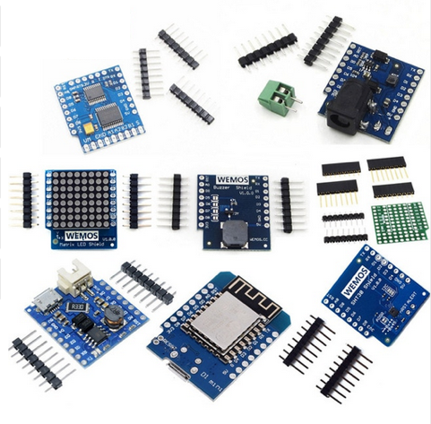
The ideal IoT solution?
ESP8266 or ESP32 processor board
ESP8266 specs:
WiFi on chip
10 bit ADC on chip
80 kByte RAM
4 Mbyte flash
Can run a MicroPython interpreter
Can be programmed through Arduino IDE
SPI, I2C interfaces
11 GPIO pins
Many sensor and actuator boards
Can be plugged together without bread board or soldering
Cost of processor board: ~ 2.5 US$
ESP32 is even more powerful Cost: ~ 4.5 US$

Slide 16
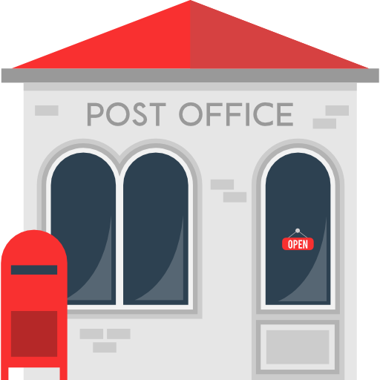
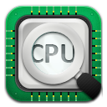
Communication
MQTT (Message Queuing Telemetry Transport): a publish-subscribe based
Message protocol running of top of TCP.
A processor can subscribe to messages of a certain “topic” and/or it can push its
results on a certain topic broke
publish
subscribe

Slide 17
Programming language
Only the data recovered from the communication protocol are seen
Any programming language will do
Cayenne/MQTT libraries are available for
C, C++
Python
Java
Java Script
ESP8266 and ESP32 are powerful enough to run a MicroPython interpreter Let’s use Python

Slide 18
Introduction to Python
The python programming language is a high level programming language that is very interactive and object oriented.
Python is an interpreted language which means that the statements which make up the python program is processed at run-time but not compiled first.
Python also supports object oriented programming style which employs the use of encapsulating codes within objects.

Slide 19
Introduction to Python
What can python be used for?
Used to create web applications.
Used to connect to database systems.
It can be used to perform complex mathematics
It can be used in data analysis.
If you want to learn Python, Try the Python tutorial!
For Python beginners https://docs.python.org/3/tutorial/index.html
For everyone the Python docs https://docs.python.org/3/index.html

Slide 20
Writing Python Programs
Python is a programming language that lets you work more quickly and integrate your systems more effectively.
Python is powerful... and fast;
plays well with others;
runs everywhere;
is friendly & easy to learn;
is Open.
Python programs can either be written using any standard editor like nano, emacs as a script or can be written from the python command line.

Slide 21
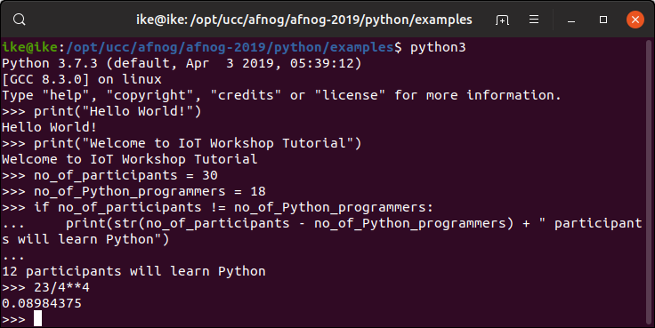
Using the Command Line (Interactive mode)
Simply type python3 in your terminal and press the enter key to start the interactive python mode.
Type print(“Hello world”). Hit enter and it prints Hello world on the screen. Type quit()

Slide 22
Using the script mode
Using the interactive mode doesn’t keep the statements of code we wrote permanently .
But in an ideal situation we might want to keep the codes for future reference.
Hence we make use of an editor like the nano, emacs, etc.

Slide 23
Using Thonny
Instead of running a standard editor like nano or emacs you may want to run an Integrated Development Environment (IDE) created specifically for Python instead.
Thonny is Easy to get started. Thonny comes with Python 3.7 built in, so just one simple installer is needed and you're ready to learn programming.
It is very suitable for beginners and programming micro-controllers
For basic description of Thonny check https://thonny.org/ and https://realpython.com/python-thonny/

Slide 24
Thonny Python Shell and Editor
Here you see the 2 thonny windows.
The top one contains the editor, the second the Python shell

Slide 25
Idle Python Shell & Editor
Here you see the 2 idle windows.
The top one contains the editor, the second the Python shell

Slide 26
Running a Python Script
Script in python can be run from the Linux command shell with: python3 scriptName
or
we can make it executable and run it like we would run any compiled C program or any bash script:

Slide 27
Command Line Arguments
Programs can be called with arguments.
Python has a module that helps users parse command-line options and arguments.
Many programs can be run to provide basic information about how they should be run and it employs the use of command line arguments.
The Python sys module provides access to any command-line arguments via the sys.argv .

Slide 28
Command Line Arguments

Slide 29
Variables
Variables are just memory allocations for storing values.
Every variable created has a space in memory allocated for it.
Based on the data type of a variable, the interpreter allocates memory and decides what can be stored in the reserved memory.
Python variables do not need explicit declaration to reserve memory space.
The declaration happens automatically when you assign a value to a variable.
The equal sign (=) is used to assign values to variables.
The operand to the left of the = operator is the name of the variable and the operand to the right of the = operator is the value stored in the variable.

Slide 30
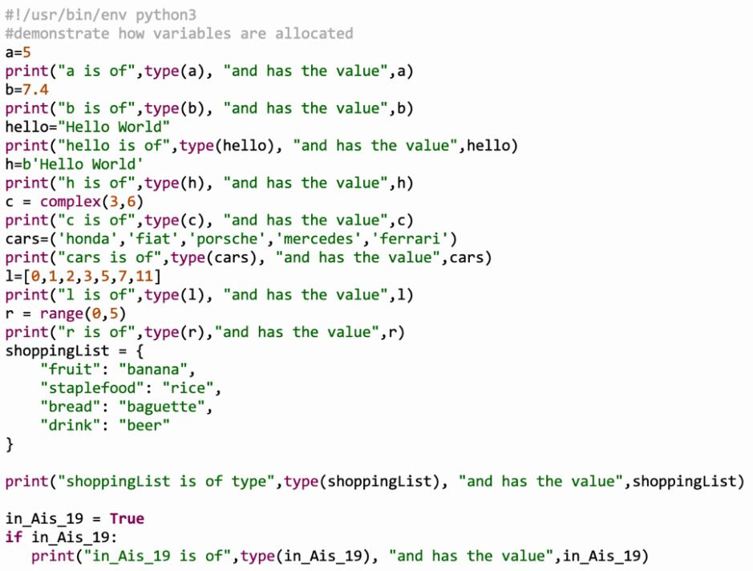

Slide 31
Data Types in Python
Programs store data in one form or the other and must be of a certain type.
We discuss the following data types
Strings
Lists
Tuple
Dictionary

Slide 32
Strings
Strings in Python are identified as a contiguous set of characters represented in the quotation marks.
Python accepts either pair of
single,
double quotes and
triples(single/double) quotes.

Slide 33
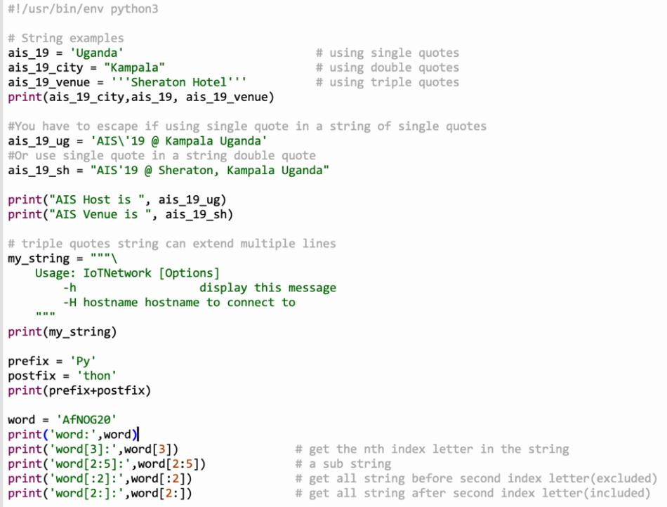

Slide 34
List
The list is the most versatile datatype available in Python.
It can be written as a list of comma-separated values (items) between square [] brackets.
A list need not be of the same type.
The values present in a list are indexed starting from zero.
The values stored in a list can be accessed using the slice operator ([ ] and [:]) with indexes starting at 0 in the beginning of the list and working their way to end -1.

Slide 35
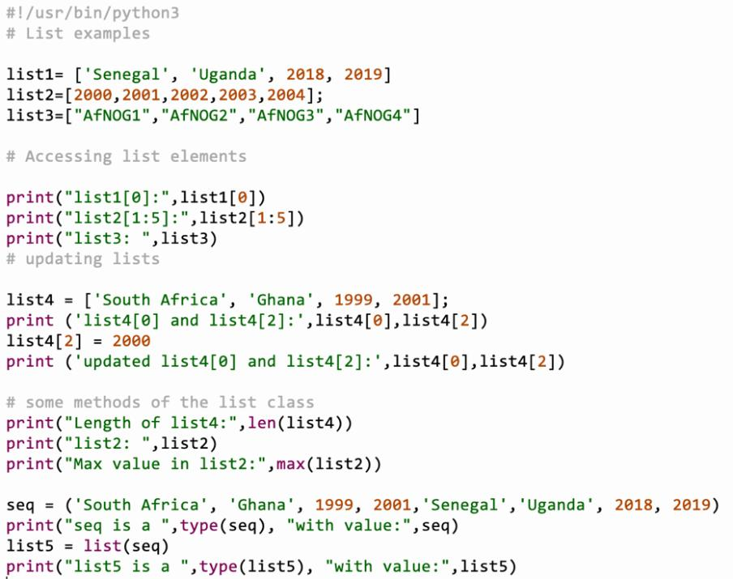

Slide 36
Tuple in Python
Tuples are much more like a list.
They are enclosed in brackets().
Their content cannot be changed unlike the list whose content can be changed.
Thus tuples are read only.

Slide 37
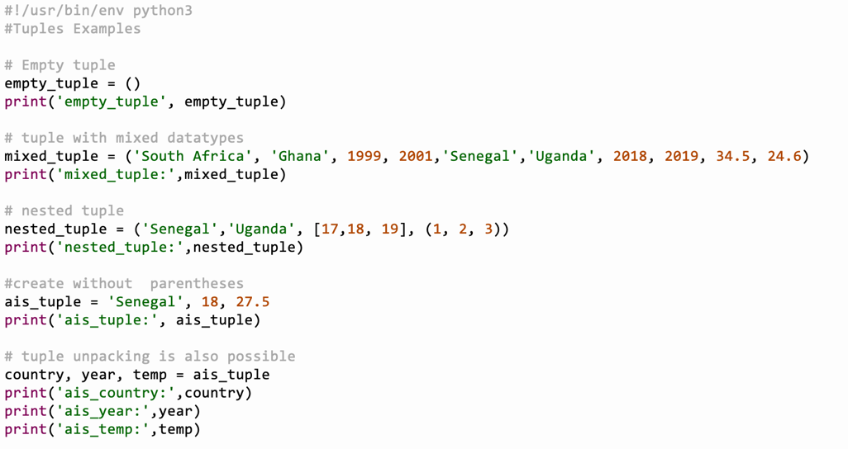

Slide 38
Dictionary in Python
A dictionary is a collection which is unordered, changeable and indexed.
In Python dictionaries are written with curly brackets, and they have keys and values.
Python's dictionaries allow you to connect pieces of related information.
Each piece of information in a dictionary is stored as a key-value pair.
When you provide a key, Python returns the value associated with that key.
You can loop through all the key-value pairs, all the keys, or all the values.

Slide 39
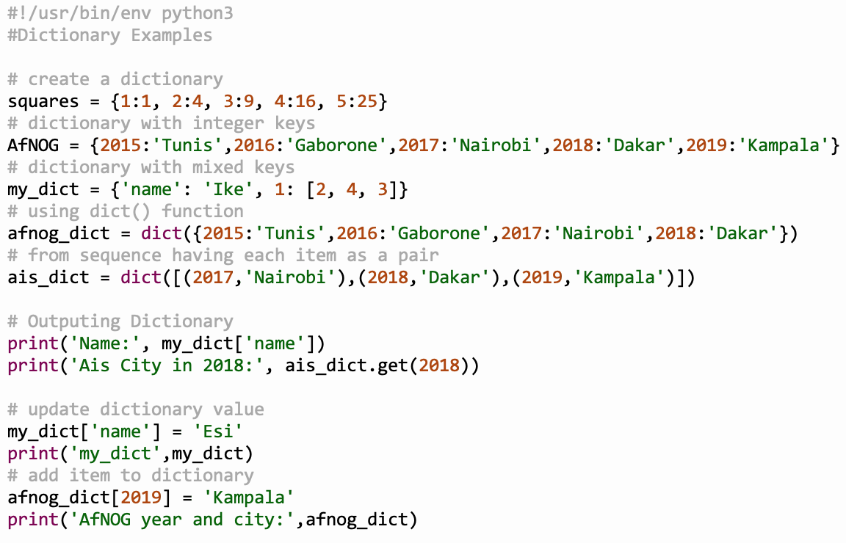

Slide 40
Basic Operators
Python supports multiple operators including
arithmetic,
comparison,
assignment,
logical,
bitwise,
membership and
identity operators.

Slide 41
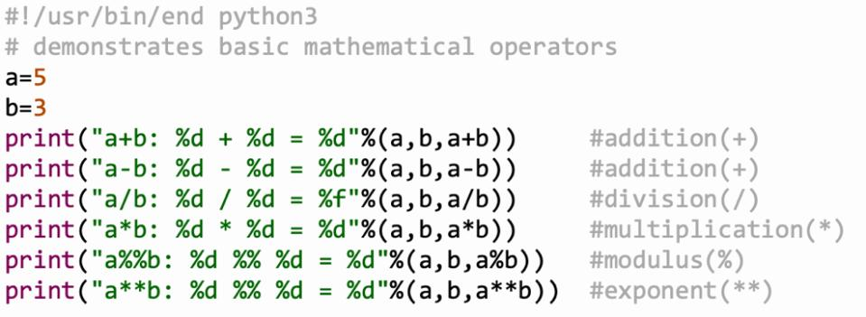

Slide 42
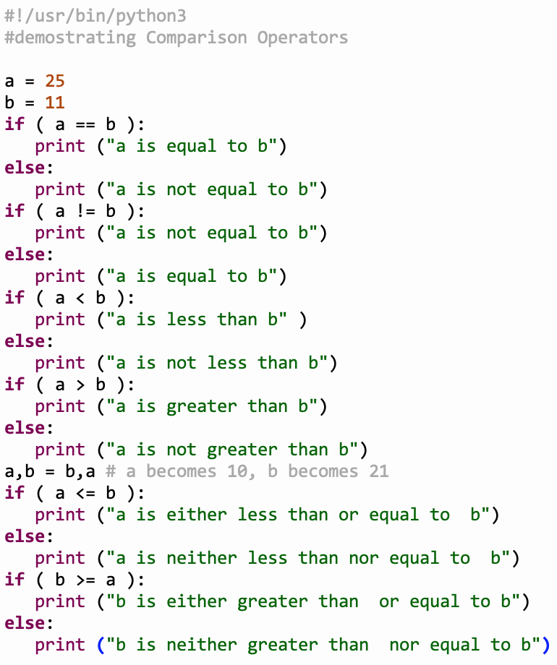

Slide 43
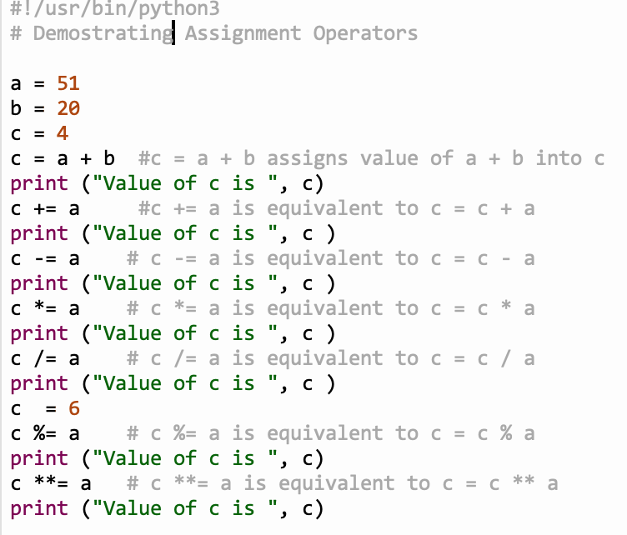

Slide 45
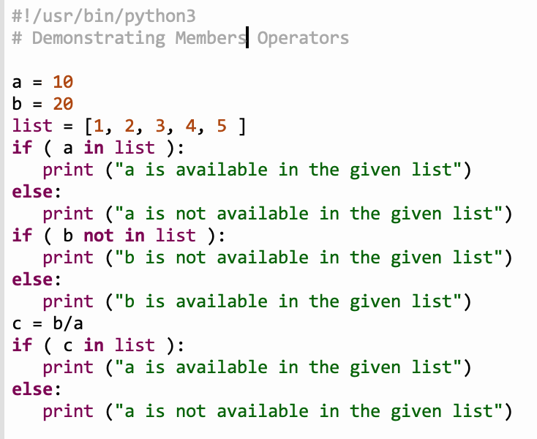

Slide 46
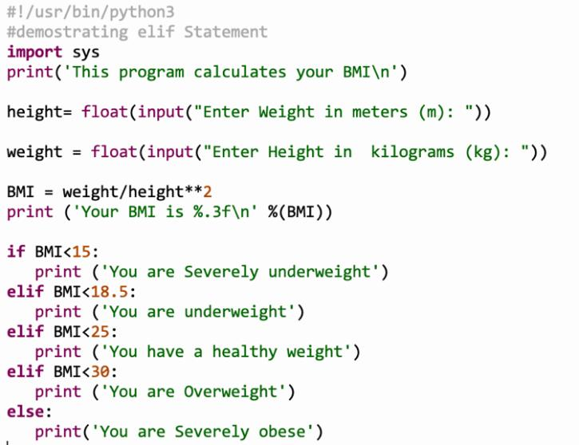
Conditional Statements

Slide 47
Loops
A loop statement allows us to execute a statement or group of statements multiple times.
Python has two primitive loop commands:
while loop
for loops

Slide 48
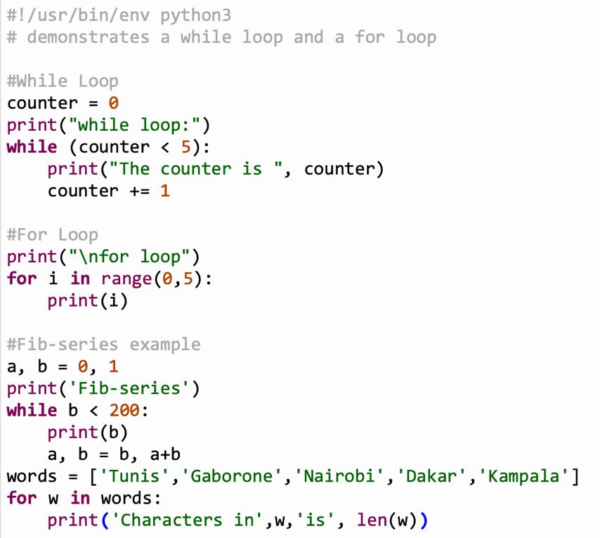

Slide 49
Functions
Programs are written in blocks of codes which are reusable but performs similar actions.
Python comes with built-in functions such as print().
Users can define and use their own functions in the code.
User defined functions begin with the keyword def followed by the name of the function.
A function may take parameters

Slide 50
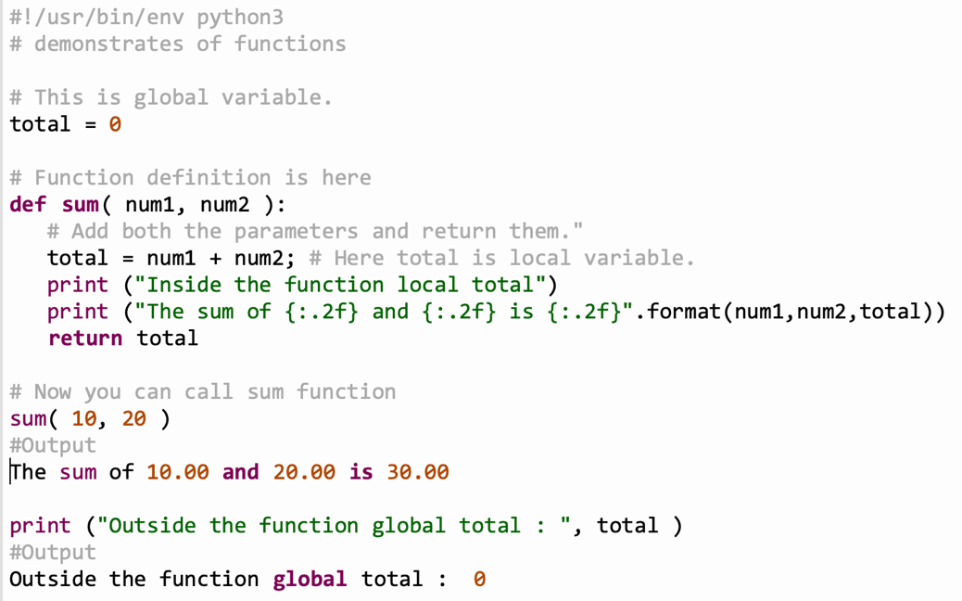

Slide 51
Modules
Modules in a python are file with .py extensions containing definitions of functions or variables.
In our example of the functions we can save the definitions in a file called function.py
In order to use the definitions we must import them with
import function
In order to call the functions we have to use the module name: function.sum(20,30). if we we want to import a single function: from function import sum sum(20,30)
The module name is found in the variable __name__

Slide 52
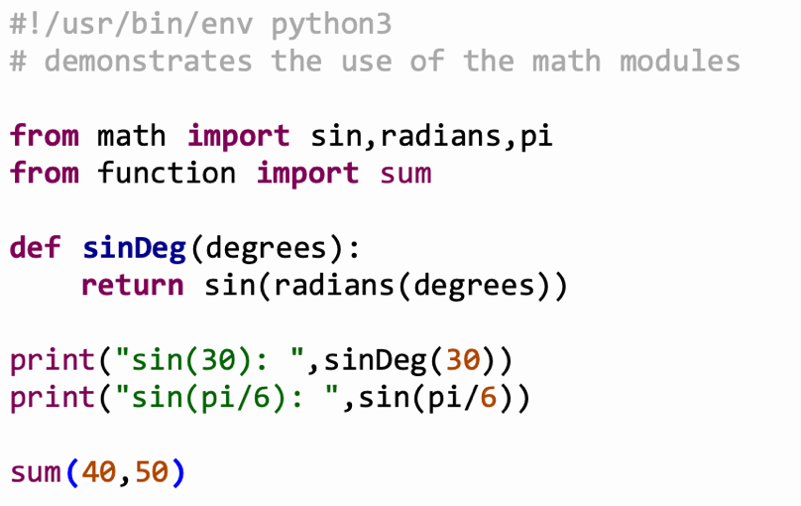

Slide 53
Executing Modules
Often modules contain only function or class (see later) definitions
However it is also possible to include the function calls (the main routine) into the module e.g. to demonstrate how the functions are to be used.
In this case the name of the module changes to __main__
We can therefore find out if the module is imported or executed by checking the name variable: __if name__ == "__main__"
this executes the main code only if not imported into a main program

Slide 54
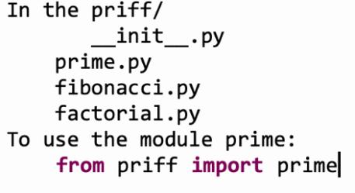
Packages
Packages simply group modules under one name.
Each package is a directory which MUST contain a specific file called __init__.py indicating the directory is a package.
the __init__.py file may be empty.
Package can be imported the same way as module.
Suppose we have several modules prime.py, fibonacci.py, factorial.py in a directory, we may group them in a package called priff.

Slide 55
Class
Almost everything in Python is an object, with its properties and methods.
A class defines the behavior of an object and the kind of information an object can store.
The information in a class is stored in attributes, and functions that belong to a class are called methods.
A child class inherits the attributes and methods from its parent class.

Slide 56
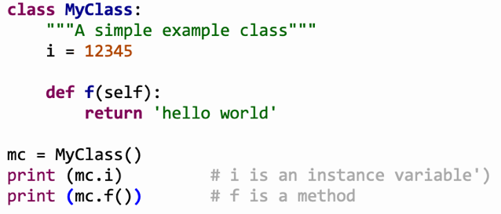
The syntax for creating a class is similar to functions
You may define a method with name __init__which is called when
the instance object of the class is created (in the above example: mc = MyClass)
The short description of the class can be found in the instance variable __Doc.__

Slide 57
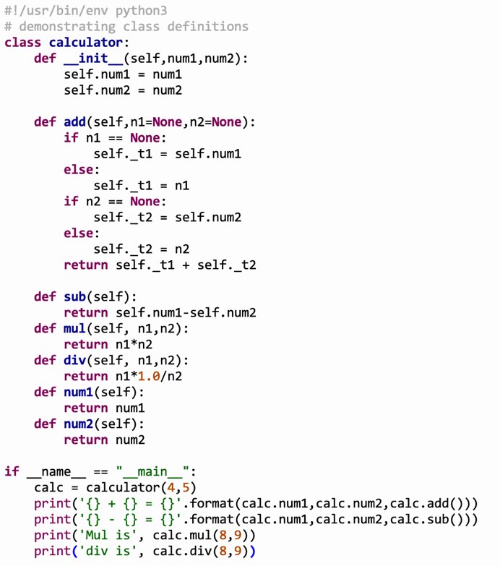

Slide 58
Libraries
Python library is a collection of functions and methods that allows you to perform many actions without writing your code
A very typical example of a python library is matplotlib for plotting.

Slide 59
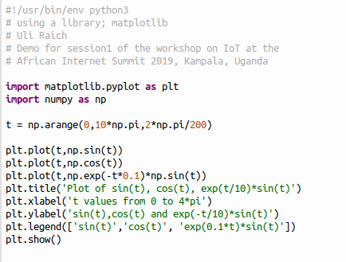
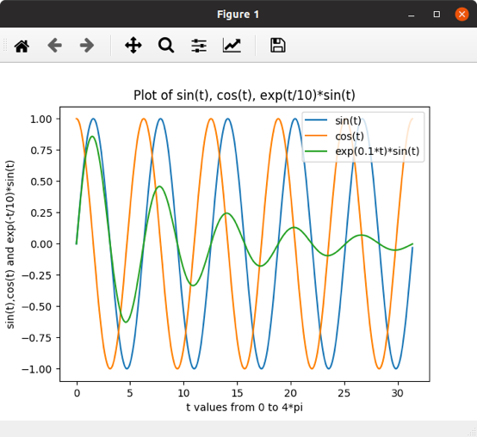

Slide 60
Callbacks
Callbacks are very often used in Graphical User Interface (GUI systems)
GUI elements (widgets) are set up by the programmer and events are attached to them.
Typical examples are:
Selection of an intern in a list
Selection on a menu item
pushing a push button
checking a check box
The GUI systems runs in an endless loop and calls pre-registered functions(the callback functions) when any of the above events happens. The event is then acted upon and control is returned to the GUI main loop.

Slide 61
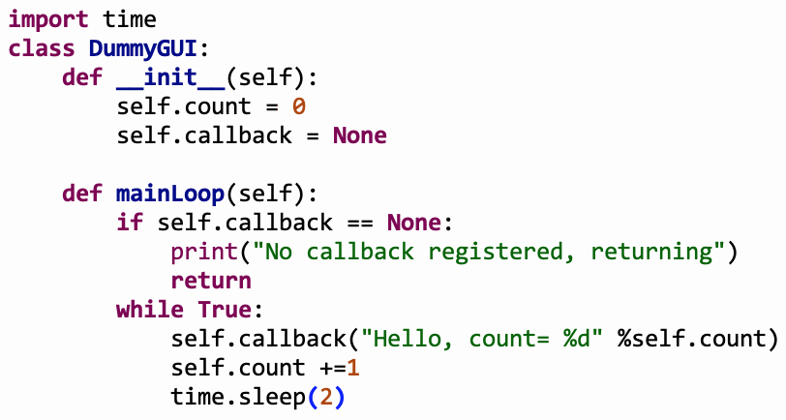
A Dummy GUI
Our dummy GUI allows to register a callback and if one is registered it will call it every 2 s.

Slide 62
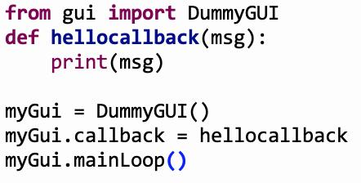
The application running the dummy GUI
The application first registers the callback and then gives control to the dummy GUI main loop.
The main loop will wait for an event (2 s elapsed) and call the callback function when the event has occurred.

